Slide 1


Clearing the Skies: Tracking Aviation CO₂ Emissions
Analyzing aviation-related CO2 emissions across countries, years, and flight types
Presented by: Mariam Ammar Alkangooni

Slide 2


Introduction
Aviation Is Among The Top 10 Carbon Dioxide Emission Sources Globally. Emissions Are Rising Due To Increased Air Travel, Yet Aviation Was Excluded From The Paris Agreement Targets (2015–2020). This Project Analyzes Domestic And International Flight Emissions Using Climate TRACE Data.
Problem Statement
Aviation Emissions Are Going Up, But We Still Don’t Fully Understand Which Countries Or Flight Types Are Responsible For Most Of It. We Also Don’t Know How Population Or The Number Of Airports Might affect emissions. We Need To Understand These Patterns Better So We Can Take Action.

Slide 3


Goals
To explore aviation CO₂ emissions using simple data and visuals. This will help us know which countries and flight types (domestic or international) produce the most emissions.
Objectives
Explore aviation carbon emission patterns across countries.
Compare domestic and international aviation emissions.
See how emissions changed from 2021 to 2024.
Check if population or number of airports affects emissions.

Slide 4




Data overview
Monthly Emission Records
Time period
476.41 K
2021-2025
Countries covered in the dataset
flight type
International 50.41%
Domestic 49.41%
237

Slide 5
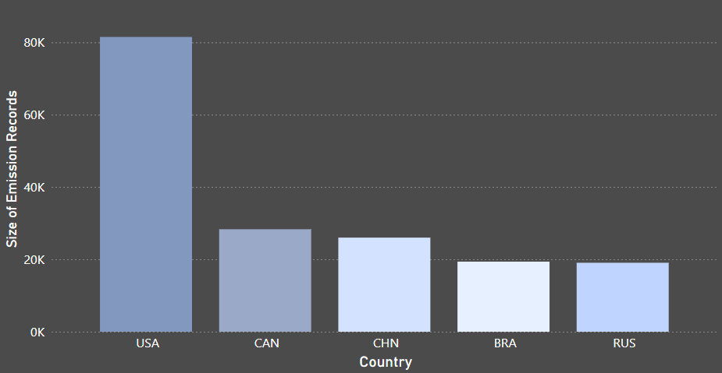
Top 5 countries by aviation emissions
United states
Canada
China
Brazil
Russia
These 5 countries produce the highest flight-related emissions in the world. Most of them have busy airports and high passenger traffic

Slide 6
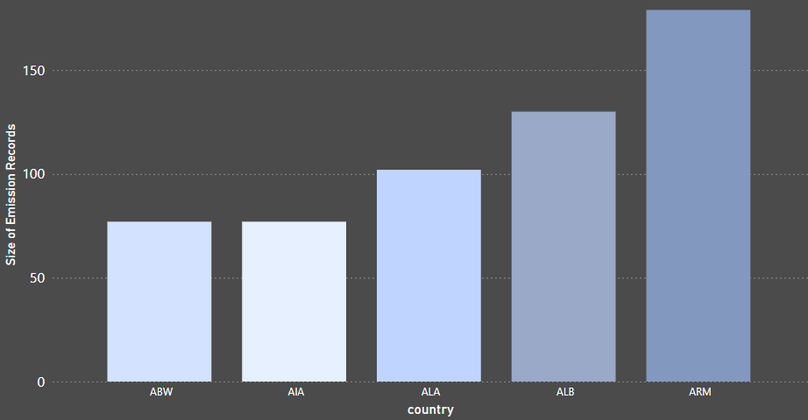
Bottom 5 countries by aviation emissions
Aruba
Anguilla
Åland Islands
Albania
Armenia
These countries have low aviation emissions, likely because they have fewer airports, smaller populations, or less flight activity.

Slide 7
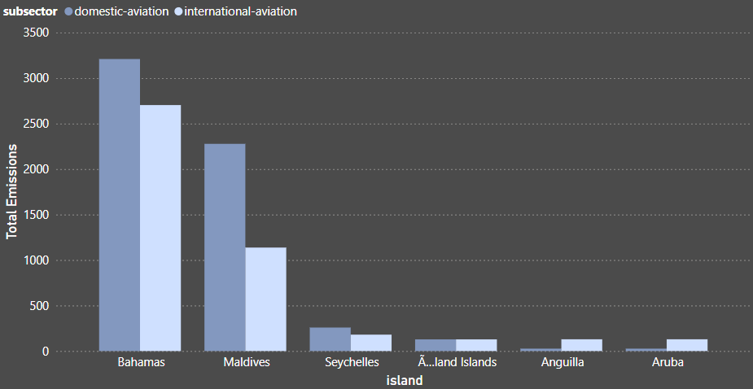
Top Emitting Island Countries by Flight Type

Slide 8
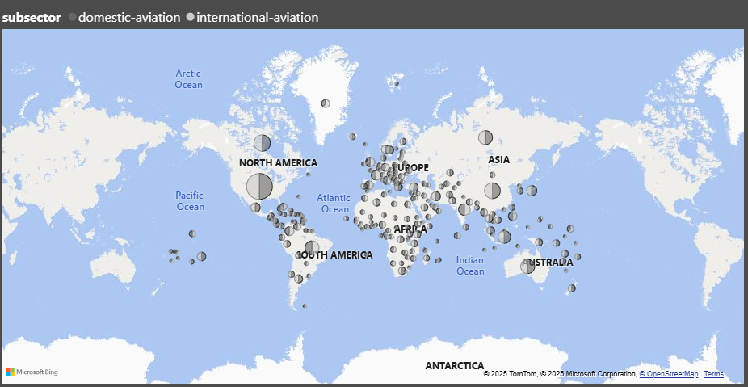
Flight emissions by country and flight type
This map shows where aviation emissions are highest. Colors represent different flight types: domestic and international. Some countries have high levels from both.

Slide 9
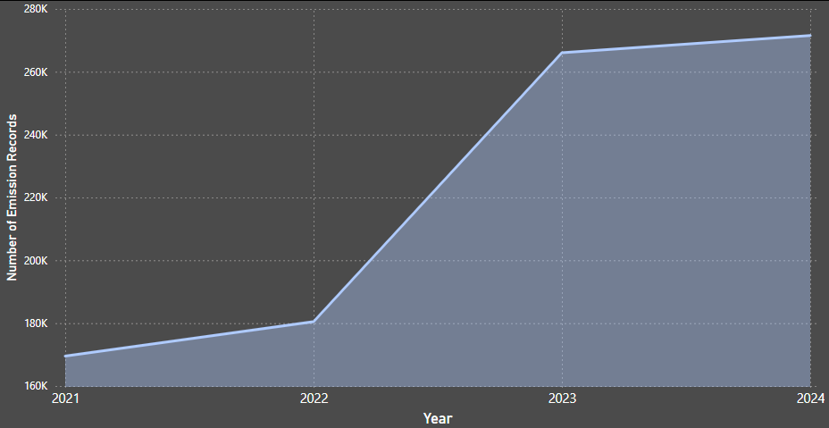
Yearly emissions trend(2021-2024)
2025 data excluded due to incompleteness
This chart shows how aviation emissions changed from 2021 to 2024. We can observe changes over the years, which may reflect shifts in flight activity or reporting.

Slide 10
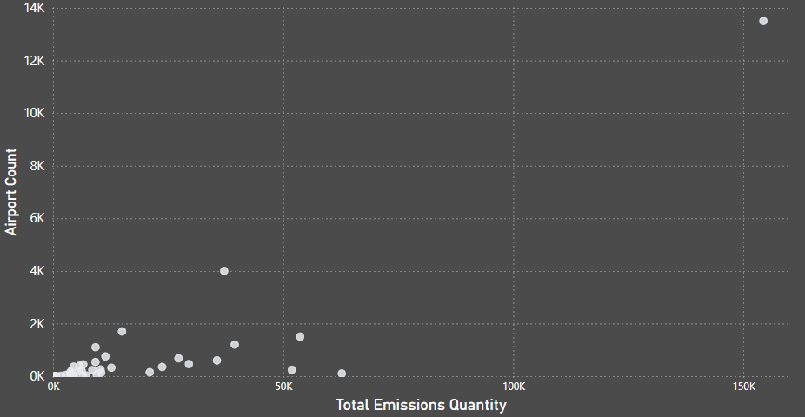
Emissions vs. Number of Airports per Country

Slide 11
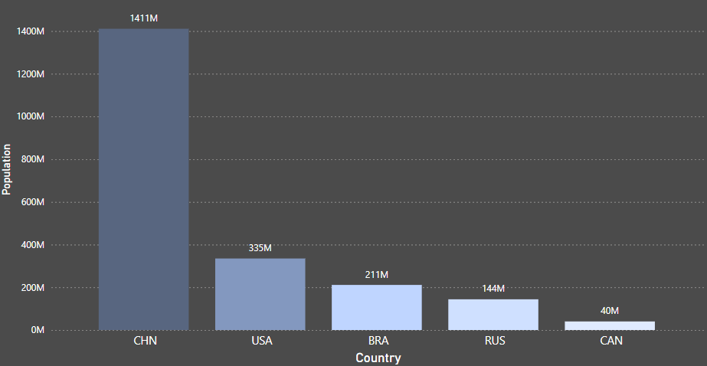
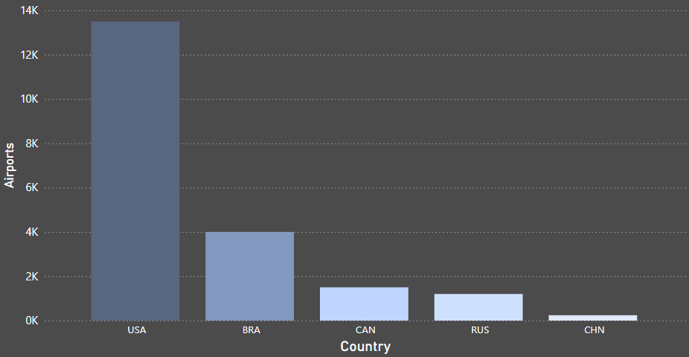
Population & Airport Count in Top Emitting Countries
China
United states
Brazil
Russia
Canada
United states
Brazil
Canada
Russia
China

Slide 12

Conclusion
Aviation emissions are not just about large countries. Emissions depend on flight type, infrastructure, and population but also show surprising patterns in small and tourist heavy nations. Understanding these trends helps build better climate strategies.

Slide 13

Recommendations
Focus emissions reduction efforts on high traffic international routes
Invest in cleaner aviation infrastructure
Re evaluate emissions responsibilities for smaller but high impact countries
Improve tracking of emissions in countries with less data but high aviation activity

Slide 14

Thank you!

